Slide 1
Planning for Progression
Do Coyle
University of Edinburgh and the Graz Group
March 2019

Slide 2
In this session:
What do we mean by learner progression?
How do we design a learning environment conducive to progression?
How might this impact on what we do in the classroom?

Slide 3
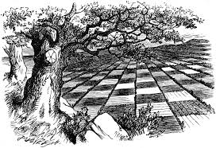
“If I had a world of my own, everything would be nonsense. Nothing would be what it is, because everything would be what it isn't. And contrary wise, what is, it wouldn't be. And what it wouldn't be, it would. You see?”

Slide 4
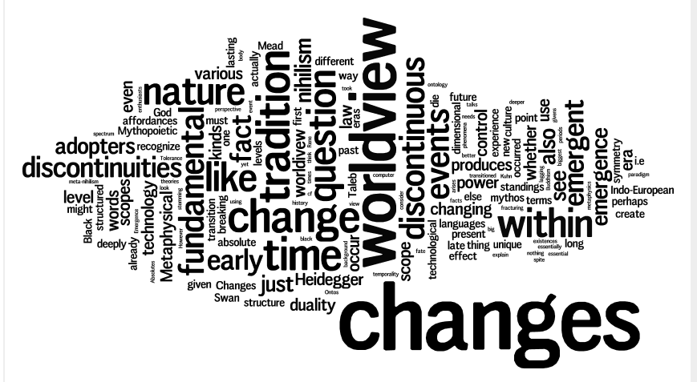
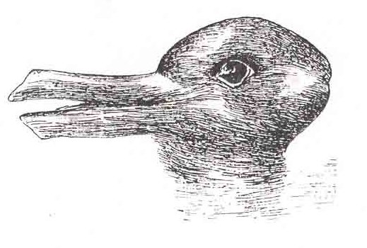
Changing paradigms

Slide 7
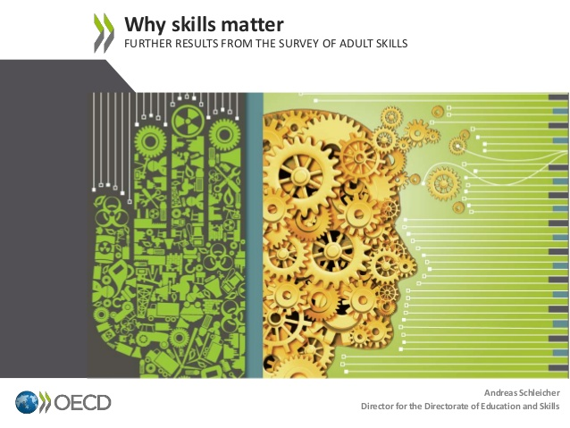
OECD 2016 proficiency in several information-processing skills – literacy, numeracy and problem-solving in technology-rich environments
To transfer

Slide 9
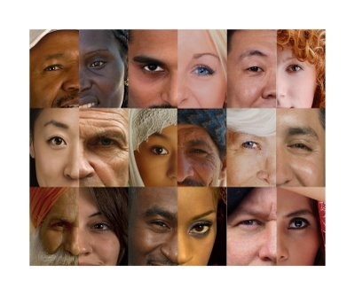
Our linguistic DNA

Slide 10
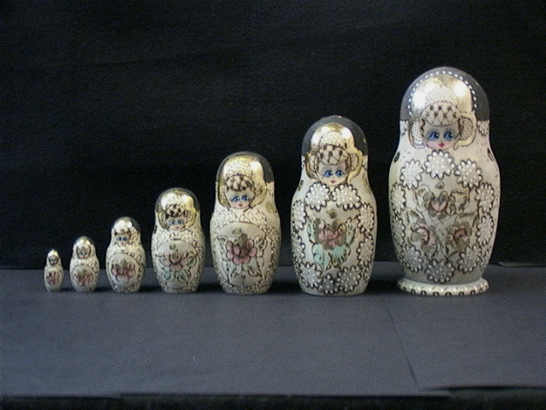

Slide 11
migrant
foreign
Monolingual
English only
EAL
outsider
insider

Slide 12
Labels, labels, labels
CLIL
EMILE
Bilingual Education
Immersion
Multilingual classrooms
Task-based learning
Content-based language learning

Slide 13
Language Using Language Learning
As teachers if we accept language is a learning tool as well as a communication tool then we have to re-conceptualise our classroom practices......to enable ‘discourse-rich’ environments
Genesee 1994

Slide 14
Focus on Language v Focus on form?
We should not let ourselves be trapped inside a dichotomy between focus on form and focus on meaning, but rather focus on language... In practice it becomes impossible to separate form and function neatly in the interactional work that is being carried out
(Van Lier 1996:203)
And if we believe that language is
our greatest learning tool ..……

Slide 15
So……
Let’s analyse learning?
What do we mean by learning?

Slide 16
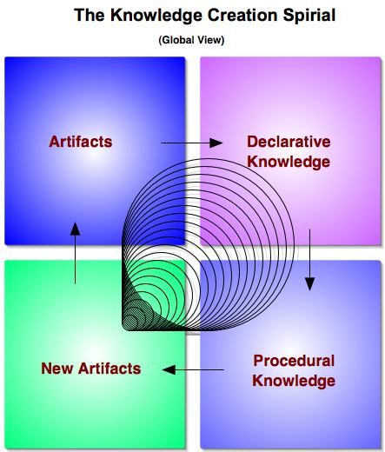
Knowledge isn’t just facts!
Factual knowledge about
Conceptual deeper knowledge about
Procedural how to (applied)
Meta-cognitive strategies

Slide 17
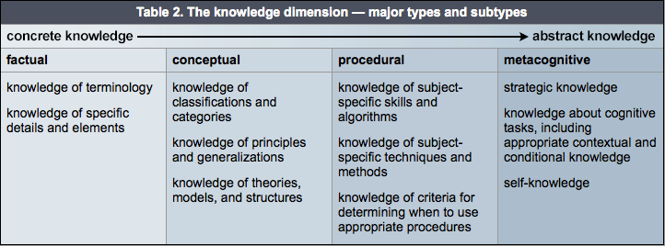
Knowledge isn’t just facts!
http://www.celt.iastate.edu/teaching-resources/effective-practice/revised-blooms-taxonomy/

Slide 18
Different types of knowledge require different kinds of language for constructing and deepening understanding..

Slide 19
Cognition is…..
……..all about the processes involved in meaning-making and conceptualising such as:
using new and existing knowledge
engaging in problem-solving
using higher order thinking skills
being creative

Slide 20
Original Terms New Terms
DEVELOPING THINKING for LEARNING
Evaluation
Synthesis
Analysis
Application
Comprehension
Knowledge
Creating
Evaluating
Analysing
Applying
Understanding
Remembering
(Based on Pohl, 2000, Learning to Think, Thinking to Learn, p. 8)

Slide 21
Focus on Language v Focus on form?
We should not let ourselves be trapped inside a dichotomy between focus on form and focus on meaning, but rather focus on language... In practice it becomes impossible to separate form and function neatly in the interactional work that is being carried out
(Van Lier 1996:203)
And if we believe that language is
our greatest learning tool ..……

Slide 22
Grammatical Correction
We are not aware of any evidence or explicit and detailed claims that the correction of errors of grammatical form is a sufficient condition for the development of oral and written language as a medium of learning
Mohan & Beckett (2003:423)

Slide 23
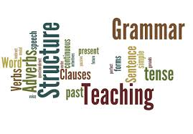
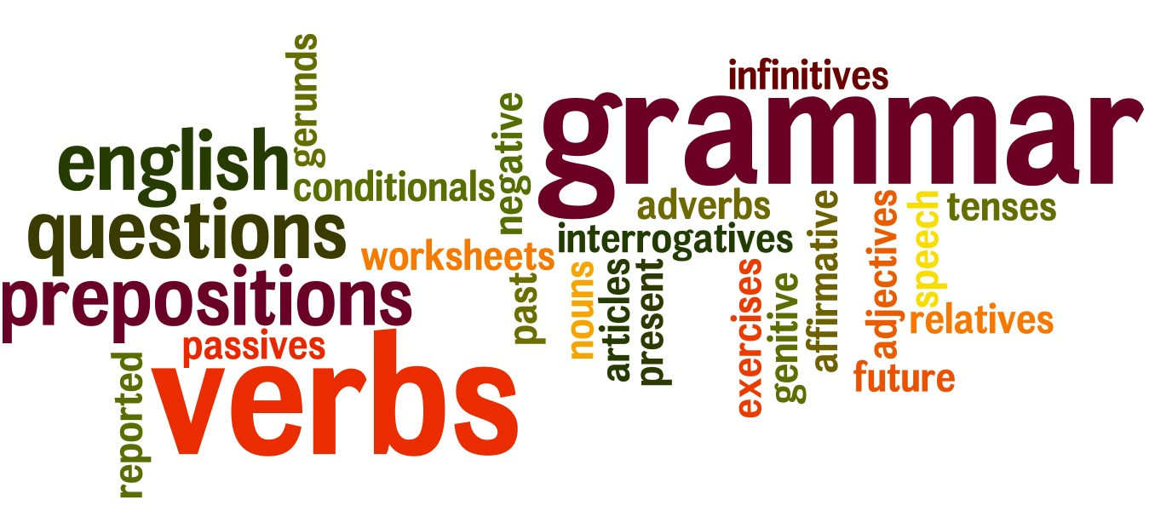

Slide 24
Growth principles
Language is a resource - we must use it.... (trans)languaging, using more than one language
Grammatical chronology as the only determinant of language use is not appropriate
If we get it right, integrated approaches are about effective learning and can serve as a model for monolingual L1 learning

Slide 25
Culture is…..
The Culture Filter
Societal cultures
(macro)
Academic Cultures
(micro)
……… the filter through which we interpret our world.
The macro level involves societal values in our home and other contexts
The micro level focuses on academic and subject-specific cultures that impact on the ways we learn and think in different areas of the curriculum.

Slide 26
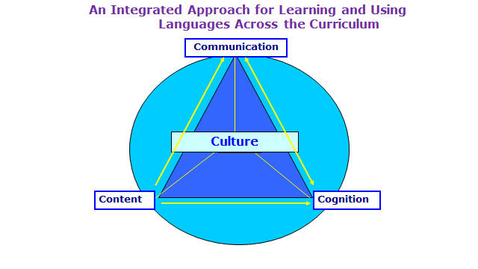
Coyle, Hood and Marsh, 2010

Slide 27
Language
is never
neutral
......

Slide 28
Growing importance of disciplinary or subject literacy on a global scale
Shanahan and Shanahan promote the idea of teaching disciplinary literacies that address the profound differences in the language used in various disciplines to construct and communicate knowledge and in ways different disciplines read and approach texts.
Dobbs et al. (2016), Fang and Coatoam (2013), Gillis (2014), Jetton and Shanahan (2012), Schleppegrell (2004) and Weinburgh and Silva (2012)

Slide 29
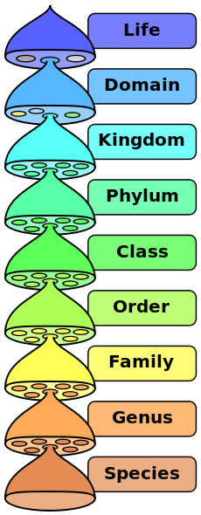
Consider.....
Biology is not plants and animals. It is language about plants and animals... Astronomy is not planets and stars. It is a way of talking about planets and stars (Postman, 1986:3)

Slide 30
Behaving like a scientist NRC Framework 2011
Identifying 8 science practices:
Asking questions and defining problems
Developing and using models
Planning and carrying out investigations
Analysing and interpreting data
Using mathematical and computation thinking
Constructing scientific explanations
Engaging in argument and discussion
Obtaining, evaluating an communicating information

Slide 31
Integrating learning.…
Integrated learning is all about progression
Content only becomes meaningful when it is understood (conceptualised) but…
Conceptualisation requires language to be used creatively and according to subject- specific rules – appropriate language use makes understanding visible.
This process involves language learning and using as embedded in content.
This process also involves deliberate transparent processes for deeper learning

Slide 32
Big Questions
What do I want my learners to know and do?
How will they demonstrate their understanding?
How do I nurture deeper understanding for progression?
How do I mentor learning and personal growth?

Slide 33
The 4Cs - Conceptual Framework
The ‘what’ but not the ‘how’
to integrate…..

Slide 34
4Cs as (Subject) Literacies for deeper learning
Meaning-making involves knowing (content) and deeper thinking (cognition) which requires language, for explaining or demonstrating individual’s understanding (communication) in ways which are culturally appropriate according to subject/topic specific discourse (culture). These processes are all about developing subject literacies.

Slide 35
Deeper learning
Deeper learning occurs when knowledges and understanding are internalised and automatised in ways which enable individuals to demonstrate their own understanding in different ways and transfer their learning to other contexts

Slide 36
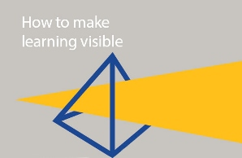
So visible learning means connecting….
academic language in the form of functions demanded by the (con)text (subject discipline or thematic content) with the language needed, learned and used…….thereby making transparent for learners with learners
subject literacies, first language, other literacies=
pluriliteracies

Slide 37
‘good’ learning is all about ‘deep’ learning

Slide 38
So what are the challenges for us as multilingual teachers?

Slide 39
Three key elements
Teachers as designers ( DLE not lessons)
Literacies - from reading and writing to academic subject-specific discourse (making literacies visible for learners)
The role of languaging as key for deeper learning

Slide 40
The lartey frimps krolacked blinfly in the detchy shilbor
Read the sentence above and answer the following:
What kind of frimps were they?
2. What did the frimps do?
3. How?
4. In what kind of shilbor did they krolack?
5. Which word is the subject in this sentence?
6. Which is the verb?

Slide 41
The lartey frimps krolacked blinfly in the detchy shilbor
7. Explain why the frimps were krolacking the detchy shilbor. Be prepared to justify your claims with facts.
8. If you had to krolack in the shilbor, which one item would you choose to have with you and why?

Slide 42
Knowledge Construction
Thinking and knowledge construction require different kinds of language which do not automatically depend on grammatical knowledge and understanding. How learners articulate their knowledge and understanding will require learning and using language appropriately

Slide 43
Reconceptualise as two strands not successive chronologies

Slide 44
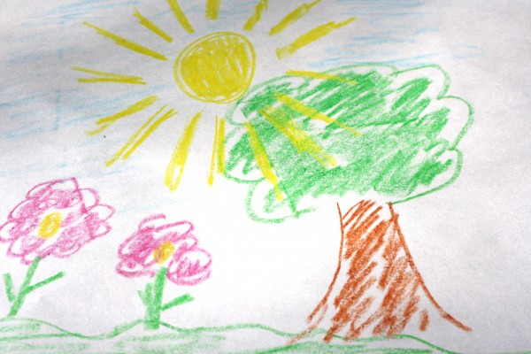
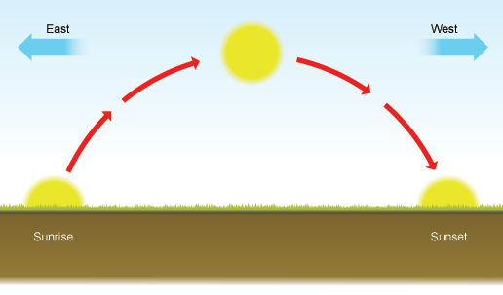
the sun doesn’t travel
but the earth rotates
Sun set
Sun rise

Slide 45
Draw this concept…..
Jupiter is the largest planet in our solar system. Its mass is approximately 318 times greater than the Earth. Jupiter is so massive, you could take every other planet in the solar system and combine them all together, and the resulting body would still be only half the mass of Jupiter. The largest planet ever found in the universe is TRES4 (which is located in constellation of Hercules), and is 70% larger than the Jupiter in diameter. Earth has an equatorial radius of 6,378.1 kilometres, whereas Jupiter has an equatorial radius of 71,492 kilometres.

Slide 46
To
Language
is a verb

Slide 47
Read this!
Subject-specific literacy develops with a growing ability to express or verbalize subject specific concepts or conceptual knowledge in an appropriate style using the appropriate genre and genre moves for the specific purpose of communication. This process is languaging i.e. using language(s) to mediate increasingly cognitively complex acts of thinking and understanding i.e. “the process of making meaning and shaping knowledge and experience through language” (Swain, 2006).

Slide 49
The demographic transition model
More houses are built
Children are warmers in bed at might because they have more brothers and sisters
There are more golden weddings
Grandparents are rare
People are encouraged to emigrate to the colonies
The public health inspector sees the new sewers completed
A mother sobs over the grave of the last of her six children died in a typhoid epidemic
Fewer children share a bedroom
Parents are starting to think more about family planning
Billy White loses his job as a grave digger

Slide 50
Which literacies as a CLIL teacher?

Slide 51
The Properties of Magnets
1. We found out that pins stuck to the magnet.
2. Some ferromagnetic materials that exhibit easily detectable magnetic properties are nickel, iron, cobalt and their alloys
3. Look! its sticking! Look at that! but that one didn’t stick!
4. Magnetic attraction occurs only between ferrous metals.
5. We discovered that a magnet attracts certain kinds of metals

Slide 52
Order them according to most everyday spoken language to the most subject specific written academic language
Where might these have occurred?

Slide 53
Text Types
1. We found out that pins stuck to the magnet (Primary, teacher guided to introduce specific terms such as repel, attract, magnetic)
2. Some ferromagnetic materials that exhibit easily detectable magnetic properties are nickel, iron, cobalt and their alloys (higher level text book)
3. Look! its sticking! Look at that! but that one didn’t stick! (primary, group work, pupil spoken language)
4. Magnetic attraction occurs only between ferrous metals.(Text book – simple)
5. We discovered that a magnet attracts certain kinds of metals (written to summarise and ensure others could understand – used more formal language)
Note: sentence construction, nominalisation, BICS/CALP

Slide 54
Thinking like....
An expert mathematician - close reading of text of essential even noting use of ‘the’ i.e. Precision reading for precision meaning
An expert chemist - interested in the transformation of information i.e. reading text requires visualisation, formulas, going back and forth between diagrams and charts, where reading involves recursive processing of representations
An expert historian - pays attention to author, source. Whilst reading working out a particular interpretation of historical events – where text is not taken as truth.
https://binged.it/2Fio0sG

Slide 55
Importance of visibility
Academic literacy must be made visible across all sectors of learning, which relates directly to subject learning. The teaching of academic literacy to all learners especially those in multilingual contexts relating to school subjects is essential. It is very different from everyday language
The continuum from everyday spoken language to highly specific subject-specific written language
How can we teach a subject without making academic literacy explicit?
(Gibbons 2018)

Slide 56
And dealing with text means….
A shift from grammatical chronological dependence
Looking at genre, register and style
Taking meaning-making seriously and enabling authentic creativity with language
Understanding what deeper learning means
Connecting with first language literacies
Using digital means to transform materials into resources
Re-thinking tasks design and sequencing

Slide 57
http://youtu.be/d1tn56vWU_g
Quantum states…
https://www.youtube.com/watch?v=IOYyCHGWJq4

Slide 58
Academic Language is nobody’s mother tongue

Slide 59
Consequences of absent discourse
Considering the fact that teaching subject specific concepts and their respective meaning extension is a central aspect of content teaching, definitions are a surprisingly infrequent phenomenon in the data. In 17 out of 43 lessons (40%) no instances of defining could be identified.
It may be unsurprising that the lexemes ‘definition’ or define’ do not occur at all in the entire corpus. And since the genre is not even named, it is equally unsurprising that there is no meta-talk about it. The written materials used during the lessons did not contain any definitions …… written definitions can also be dismissed.
Dalton-Puffer, 2004:32

Slide 60
We have a problem….
Both groups of learners show considerable deficits in their academic language use….the specific competences in handling the language dimensions adequately and in expressing their thoughts and findings appropriately or functionally according to the genre(s) demanded are equally low, they show a serious lack of command over a sensitivity for the requirements of academic language use, both in L2 and in L1 (Vollmer, 2008:272)

Slide 61
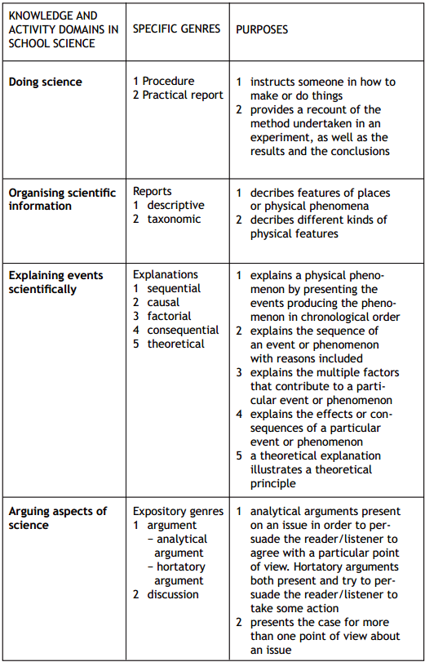

Slide 62
Starting point: Identify cognitive discourse functions and language patterns
Naming
Sequencing
Describing
Sorting from known criteria
Asking questions
Comparing and contrasting
Classifying
Explaining
Hypothesising
Generalising
Reasoning
Problem solving
Analysing
Ranking
Evaluating
Its not just about new vocabulary

Slide 63
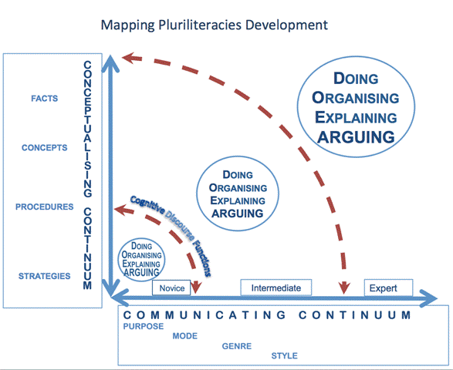

Slide 64
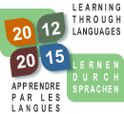
Mapping Pluriliteracies Development (The Graz Group 2013-2015)
Making learner progression
transparent in CLIL
CONCEPTUALISING CONTINUUM
Doing
Organising
Explaining
ARGUING
FACTS
CONCEPTS
PROCEDURES
STRATEGIES
Doing
Organising
Explaining
ARGUING
Cognitive Discourse Functions
Doing
Organising
Explaining
ARGUING
Progression from novice to intermediate
involves moving outwards to the next
pluriliteracy arc
Novice
Intermediate
Expert
COMMUNICATING CONTINUUM
PURPOSE
MODE
GENRE
STYLE
Notes:
Purpose of Communication (interaction): is it to coconstruct knowledge, to deliver a presentation, etc…
Knowledge expresses itself through (written) language. Building knowledge means forming concepts through mental-linguistic activities.(Vollmer PPT)

Slide 65
The Language Triptych
Coyle, Hood, Marsh, 2010

Slide 66
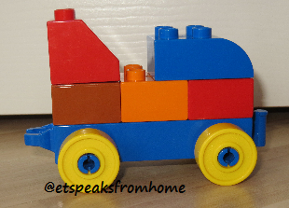
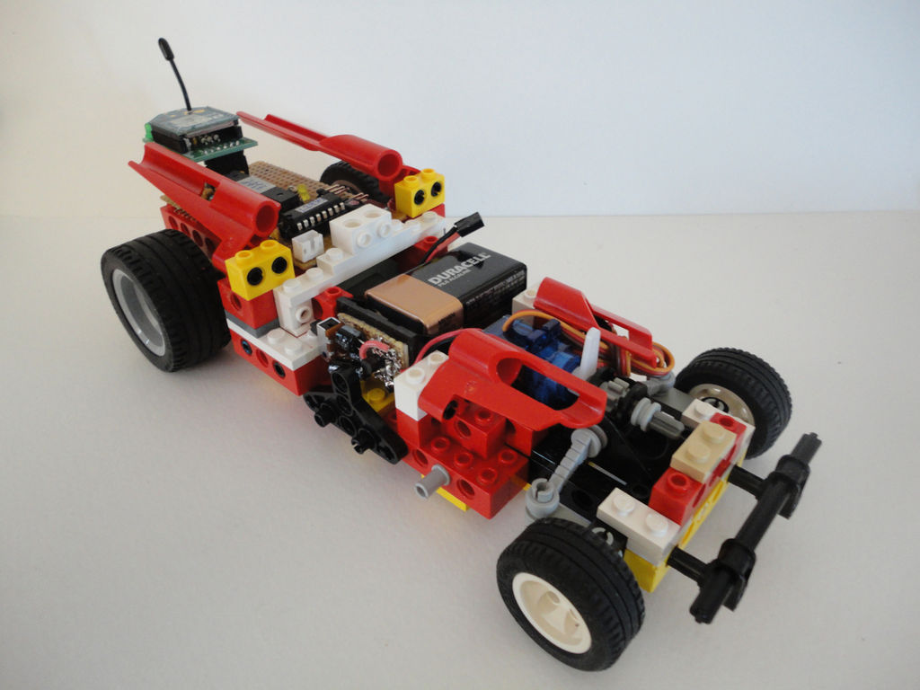
Duplo .....Lego......Lego Technic

Slide 68
Designing Deeper Learning Episodes (DLE) top down (blue, green)
5 core constructs (subject)
Different kinds of knowledges
Discourse needed (text: genre, purpose, mode, grammatical functions)
Learning Objectives related to DOEA

Slide 70
Learner-centred (orange and yellow )
Learner needs (affect and cognitive dispositions)
Learning partnerships – mentoring learning
Visibility of reflection for the learning process and what has happened in DOEA
Learning ‘subjectives’

Slide 71
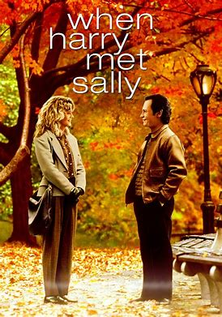
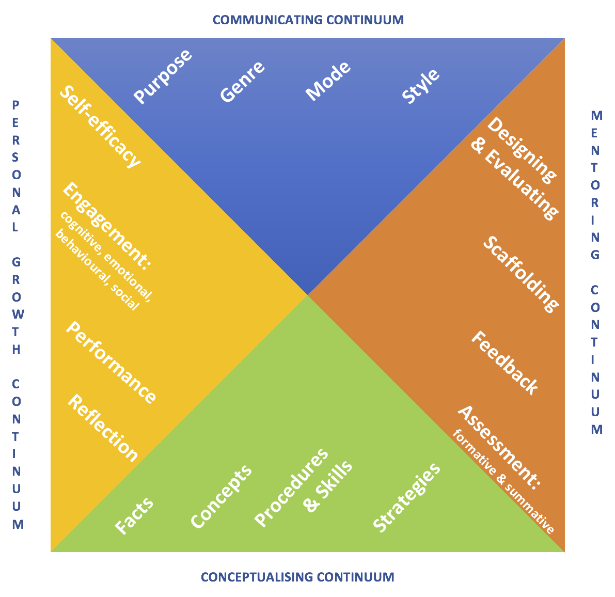
When Harry ‘meets’ Sally
Learning objectives
become
Learning ‘subjectives’

Slide 72
First Language Literacies…..

Slide 73
In this session:
What do we mean by learner progression?
How do we design a learning environment conducive to progression?
How might this impact on what we do in the classroom?

Slide 74
Take Away Messages
Learning Events – designing, planning beyond the lesson
Literacies – from general to specific across languages and modes i.e. pluriliteraties
Languaging as a key concept

Slide 75
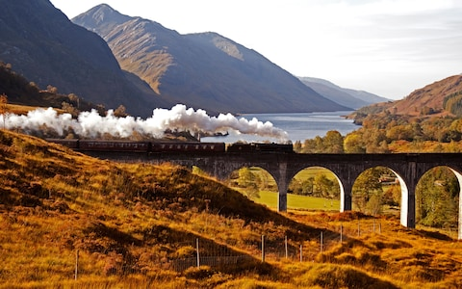
Thank you
Do.coyle@ed.ac.uk

